Slide 1
How to sort array elements ?
momedaram

Slide 2
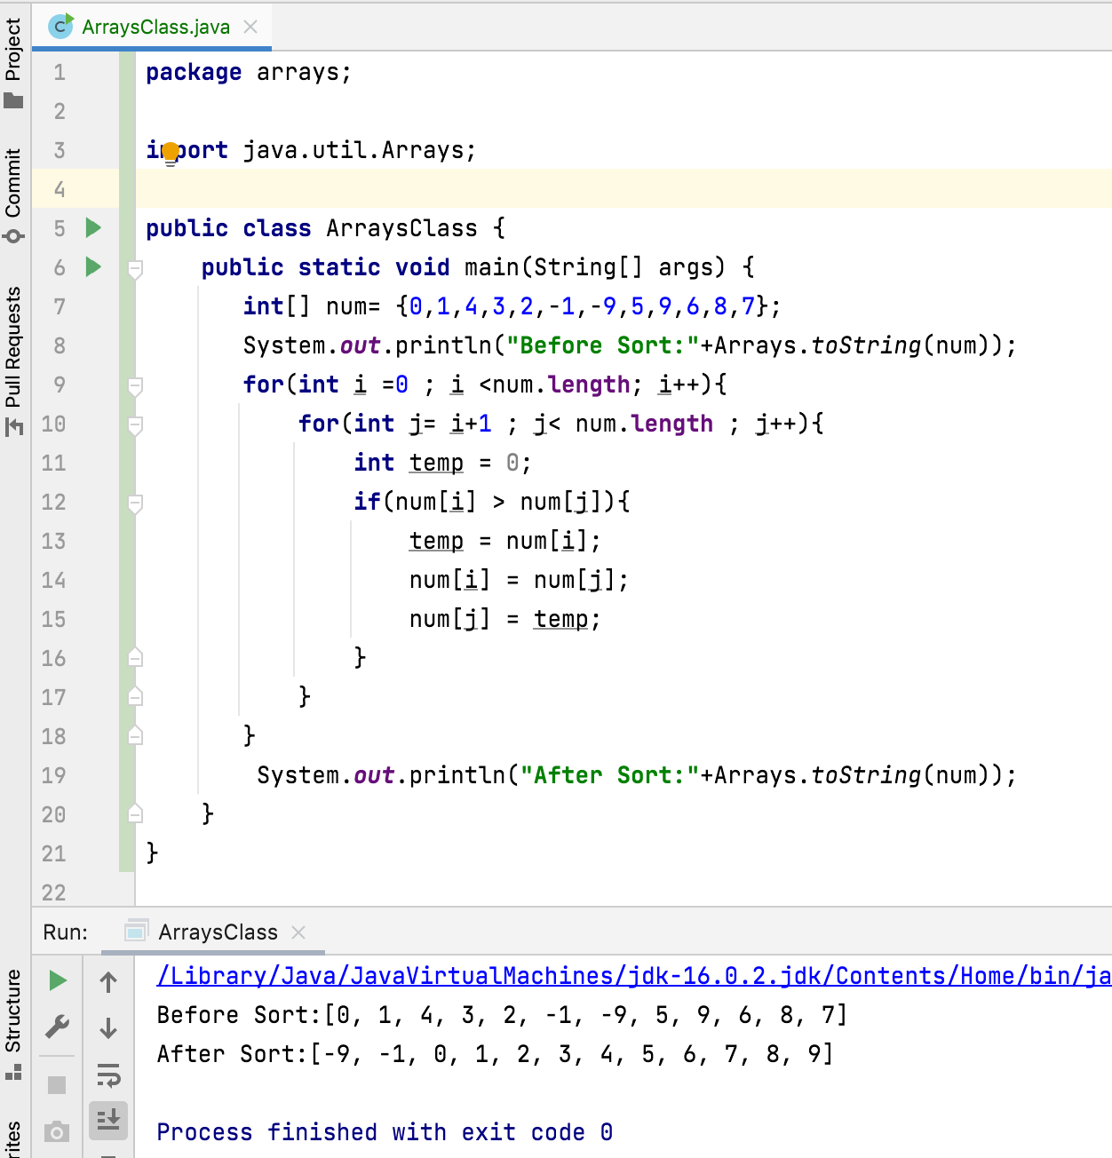

Slide 3
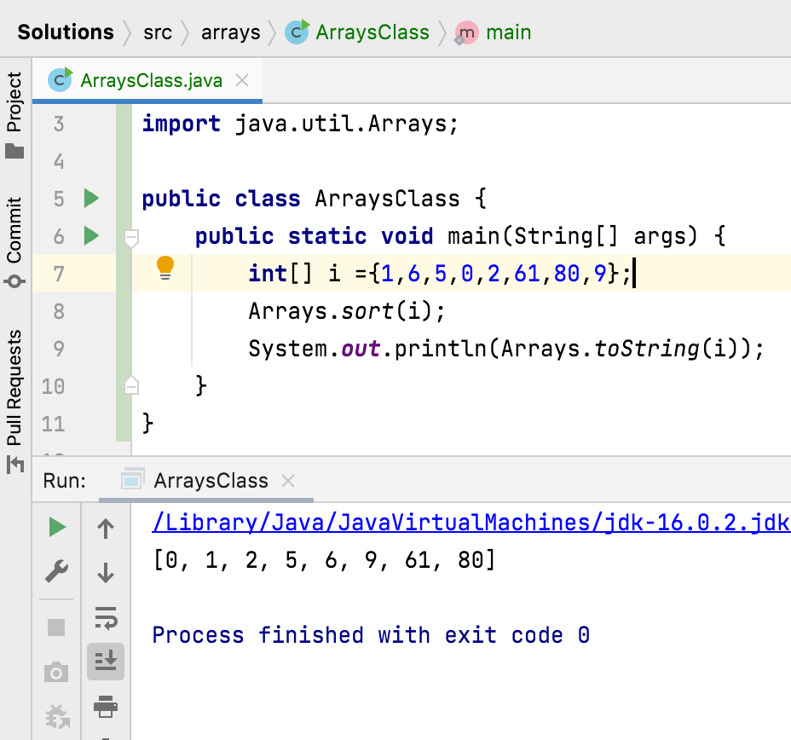
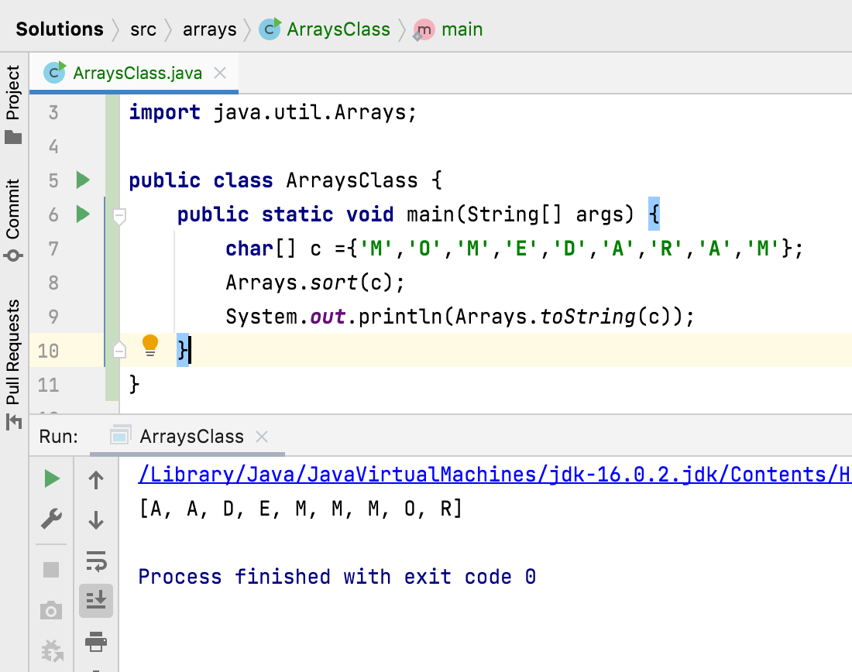
How to sort array elements ?
Arrays.sort() - Sorts the specified array into ascending order.

Slide 4
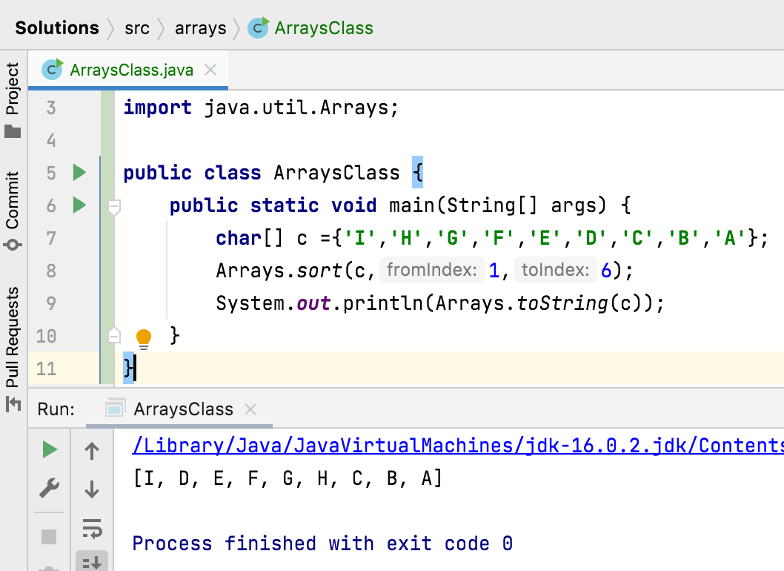
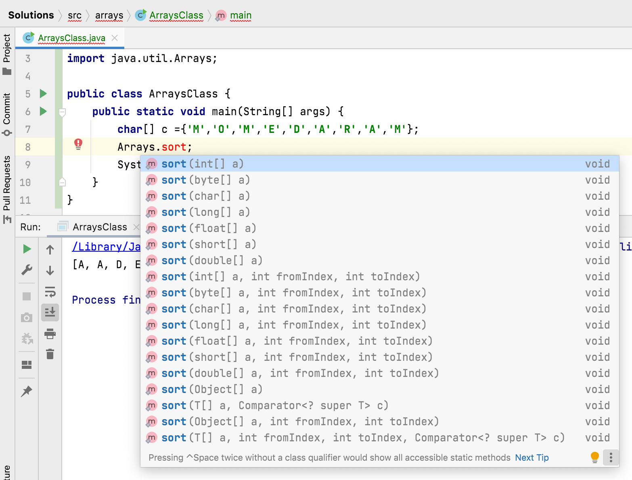

Slide 5
Thank You !
momedaram

